Slide 1
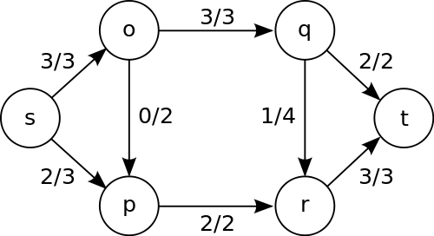
Network Graphs
Directed graph
Edge weights are now capacity
Edges have utilized/capacity
Specified Start (s) and end (t) nodes
Called Source and Sink
https://commons.wikimedia.org/wiki/File:Max_flow.svg
Notes:
(how many people/vehicles can go along that sidewalk/road, how many packets can go through this fiber each second, how many connections this link to the server can support each second, oil/water through pipes, etc.)

Slide 2
Network Graphs
Uses of network graphs?

Slide 3
Ford-Fulkerson
Initialize all edges to 0
Find an augmenting edge (forward < capacity or backward > 0) and add flow
Repeat until impossible

Slide 4
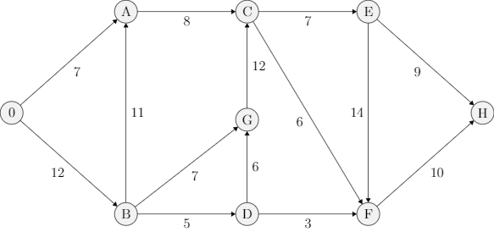
Ford-Fulkerson
Initialize all edges to 0
Find an augmenting edge (forward < capacity or backward > 0) and add flow
Repeat until impossible

Slide 5
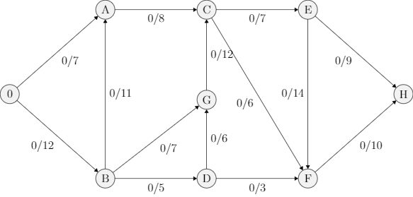
Ford-Fulkerson
Initialize all edges to 0
Find an augmenting edge (forward < capacity or backward > 0) and add flow
Repeat until impossible

Slide 6
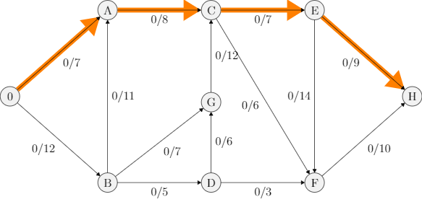
Ford-Fulkerson
Initialize all edges to 0
Find an augmenting edge (forward < capacity or backward > 0) and add flow
Repeat until impossible

Slide 7

Ford-Fulkerson
Initialize all edges to 0
Find an augmenting edge (forward < capacity or backward > 0) and add flow
Repeat until impossible

Slide 8
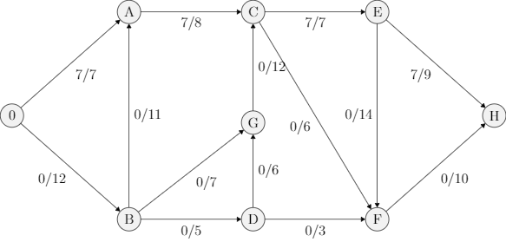
Ford-Fulkerson
Initialize all edges to 0
Find an augmenting edge (forward < capacity or backward > 0) and add flow
Repeat until impossible

Slide 9
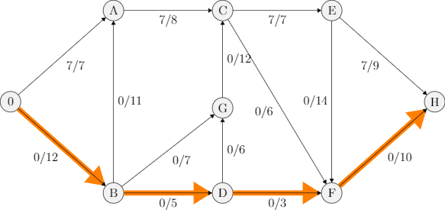
Ford-Fulkerson
Initialize all edges to 0
Find an augmenting edge (forward < capacity or backward > 0) and add flow
Repeat until impossible

Slide 10

Ford-Fulkerson
Initialize all edges to 0
Find an augmenting edge (forward < capacity or backward > 0) and add flow
Repeat until impossible

Slide 11
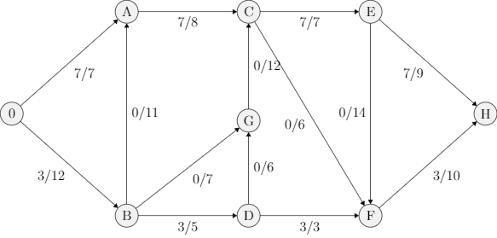
Ford-Fulkerson
Initialize all edges to 0
Find an augmenting edge (forward < capacity or backward > 0) and add flow
Repeat until impossible

Slide 12
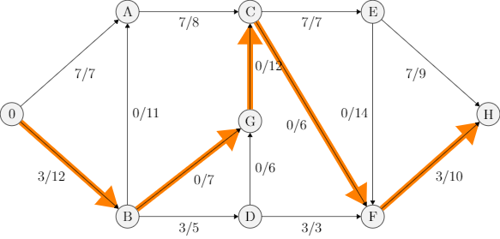
Ford-Fulkerson
Initialize all edges to 0
Find an augmenting edge (forward < capacity or backward > 0) and add flow
Repeat until impossible

Slide 13
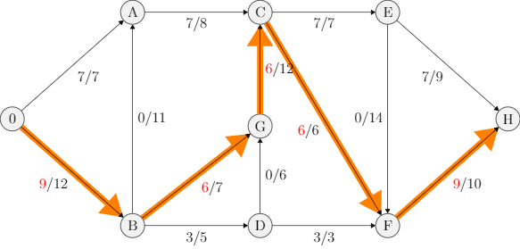
Ford-Fulkerson
Initialize all edges to 0
Find an augmenting edge (forward < capacity or backward > 0) and add flow
Repeat until impossible

Slide 14

Ford-Fulkerson
Initialize all edges to 0
Find an augmenting edge (forward < capacity or backward > 0) and add flow
Repeat until impossible

Slide 15
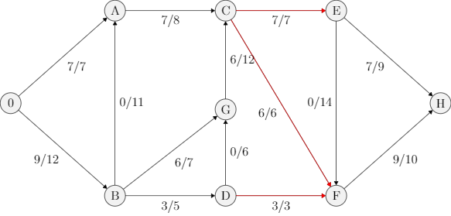
Ford-Fulkerson
Initialize all edges to 0
Find an augmenting edge (forward < capacity or backward > 0) and add flow
Repeat until impossible

Slide 16
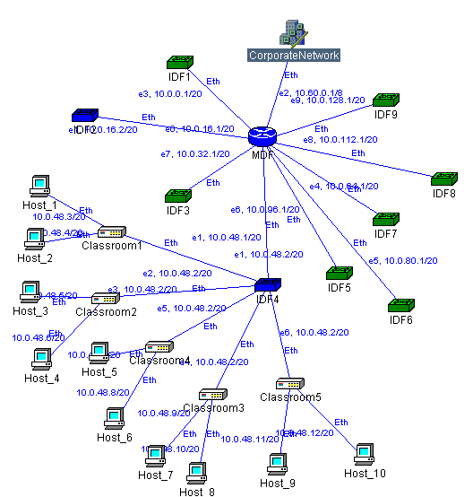
Network Cut
http://www.jeaf.com/cisco/cut.htm

Slide 17
Network Cut
http://www.jeaf.com/cisco/cut.htm

Slide 18
Ford-Fulkerson
Final Value: 16

Slide 19
Ford-Fulkerson
Initialize all edges to 0
Find an augmenting edge (forward < capacity or backward > 0) and add flow
Repeat until impossible

Slide 20
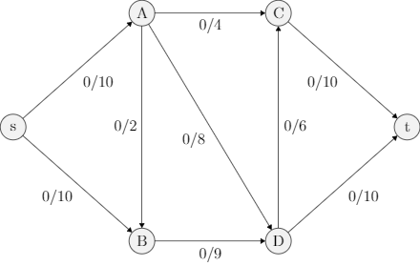
Ford-Fulkerson
Initialize all edges to 0
Find an augmenting edge (forward < capacity or backward > 0) and add flow
Repeat until impossible

Slide 21
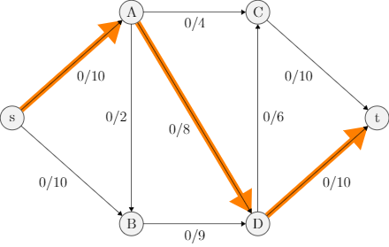
Ford-Fulkerson
Initialize all edges to 0
Find an augmenting edge (forward < capacity or backward > 0) and add flow
Repeat until impossible

Slide 22
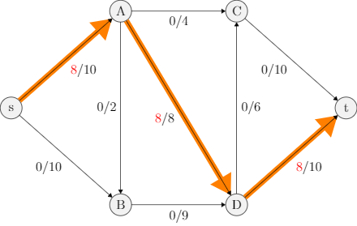
Ford-Fulkerson
Initialize all edges to 0
Find an augmenting edge (forward < capacity or backward > 0) and add flow
Repeat until impossible

Slide 23
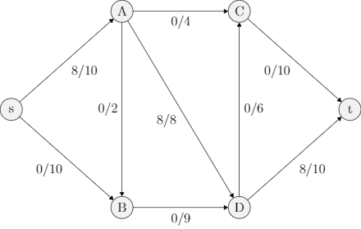
Ford-Fulkerson
Initialize all edges to 0
Find an augmenting edge (forward < capacity or backward > 0) and add flow
Repeat until impossible

Slide 24
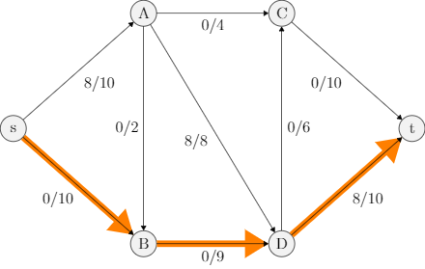
Ford-Fulkerson
Initialize all edges to 0
Find an augmenting edge (forward < capacity or backward > 0) and add flow
Repeat until impossible

Slide 25
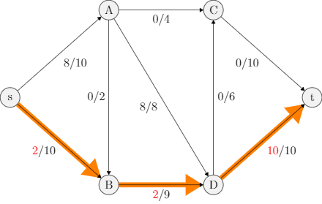
Ford-Fulkerson
Initialize all edges to 0
Find an augmenting edge (forward < capacity or backward > 0) and add flow
Repeat until impossible

Slide 26
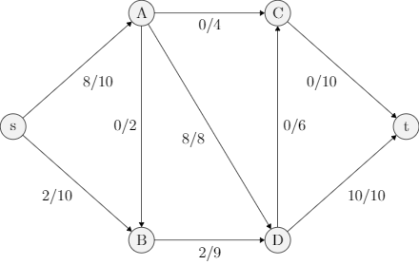
Ford-Fulkerson
Initialize all edges to 0
Find an augmenting edge (forward < capacity or backward > 0) and add flow
Repeat until impossible

Slide 27
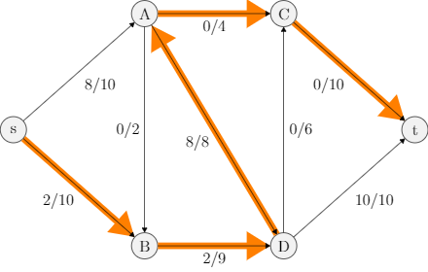
Ford-Fulkerson
Initialize all edges to 0
Find an augmenting edge (forward < capacity or backward > 0) and add flow
Repeat until impossible

Slide 28
Ford-Fulkerson
Initialize all edges to 0
Find an augmenting edge (forward < capacity or backward > 0) and add flow
Repeat until impossible

Slide 29

Ford-Fulkerson
Initialize all edges to 0
Find an augmenting edge (forward < capacity or backward > 0) and add flow
Repeat until impossible

Slide 30
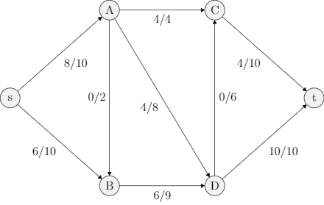
Ford-Fulkerson
Initialize all edges to 0
Find an augmenting edge (forward < capacity or backward > 0) and add flow
Repeat until impossible

Slide 31
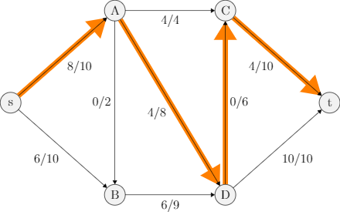
Ford-Fulkerson
Initialize all edges to 0
Find an augmenting edge (forward < capacity or backward > 0) and add flow
Repeat until impossible

Slide 32
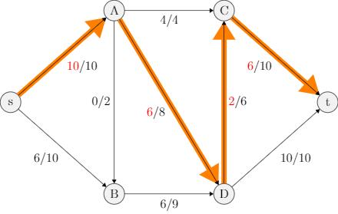
Ford-Fulkerson
Initialize all edges to 0
Find an augmenting edge (forward < capacity or backward > 0) and add flow
Repeat until impossible

Slide 33
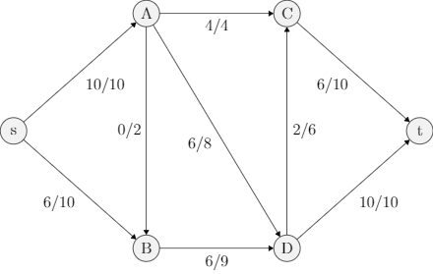
Ford-Fulkerson
Initialize all edges to 0
Find an augmenting edge (forward < capacity or backward > 0) and add flow
Repeat until impossible

Slide 34
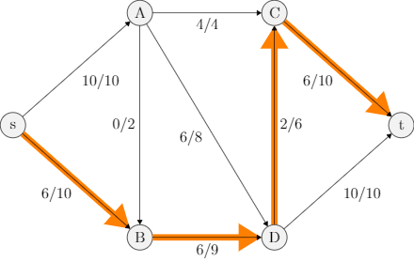
Ford-Fulkerson
Initialize all edges to 0
Find an augmenting edge (forward < capacity or backward > 0) and add flow
Repeat until impossible

Slide 35

Ford-Fulkerson
Initialize all edges to 0
Find an augmenting edge (forward < capacity or backward > 0) and add flow
Repeat until impossible

Slide 36

Ford-Fulkerson
Initialize all edges to 0
Find an augmenting edge (forward < capacity or backward > 0) and add flow
Repeat until impossible

Slide 37
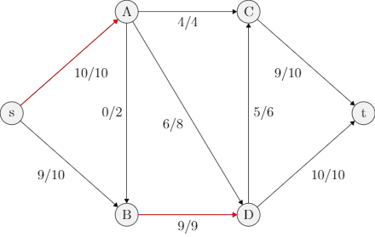
Ford-Fulkerson
Initialize all edges to 0
Find an augmenting edge (forward < capacity or backward > 0) and add flow
Repeat until impossible

Slide 38
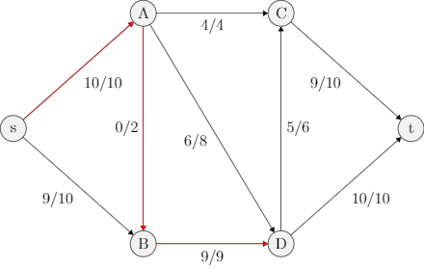
Ford-Fulkerson
Initialize all edges to 0
Find an augmenting edge (forward < capacity or backward > 0) and add flow
Repeat until impossible

Slide 39
Ford-Fulkerson
Final Value: 19

Slide 40
Ford-Fulkerson
What kind of algorithm is this?
Notes:
greedy

Slide 41
Max Flow Used?
Airline scheduling
Factory distribution
Supply chain
Maximum matching
Binary assignment
Playoff elimination
Notes:
https://en.wikipedia.org/wiki/Maximum_flow_problem#Airline_scheduling
http://jeffe.cs.illinois.edu/teaching/algorithms/2009/notes/17-maxflowapps.pdf

Slide 42
Caveats
Ford-Fulkerson does not always terminate
Ford-Fulkerson can oscillate

Slide 43
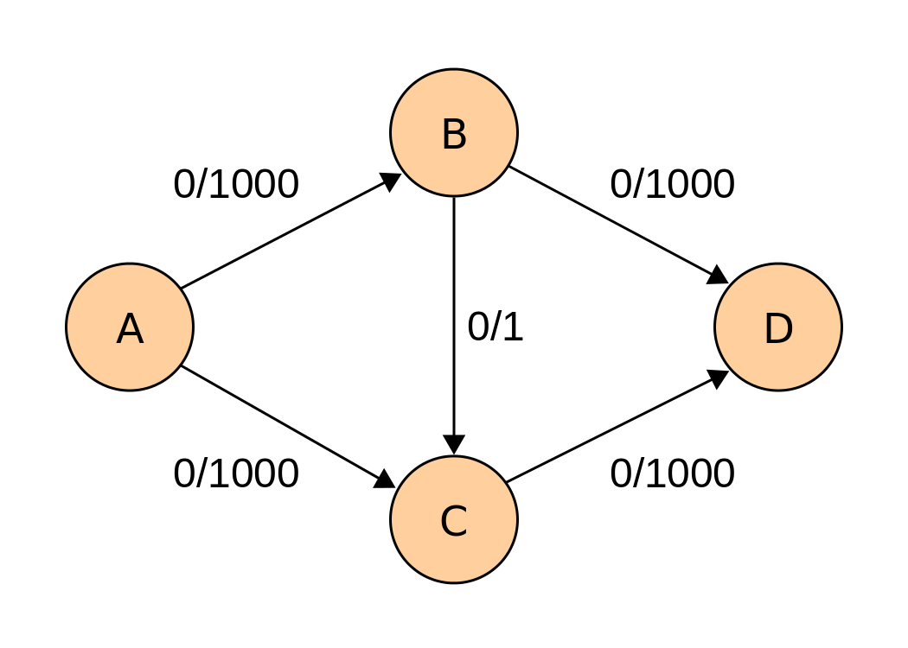
Ford-Fulkerson Problem
https://en.wikipedia.org/wiki/File:Ford-Fulkerson_example_0.svg

Slide 44
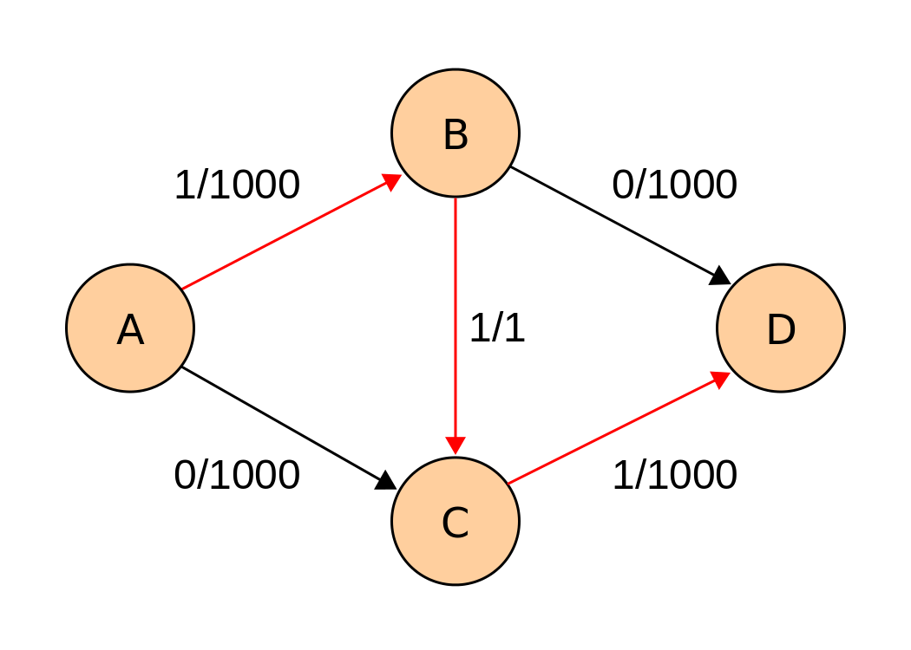
Ford-Fulkerson Problem
https://en.wikipedia.org/wiki/File:Ford-Fulkerson_example_1.svg

Slide 45
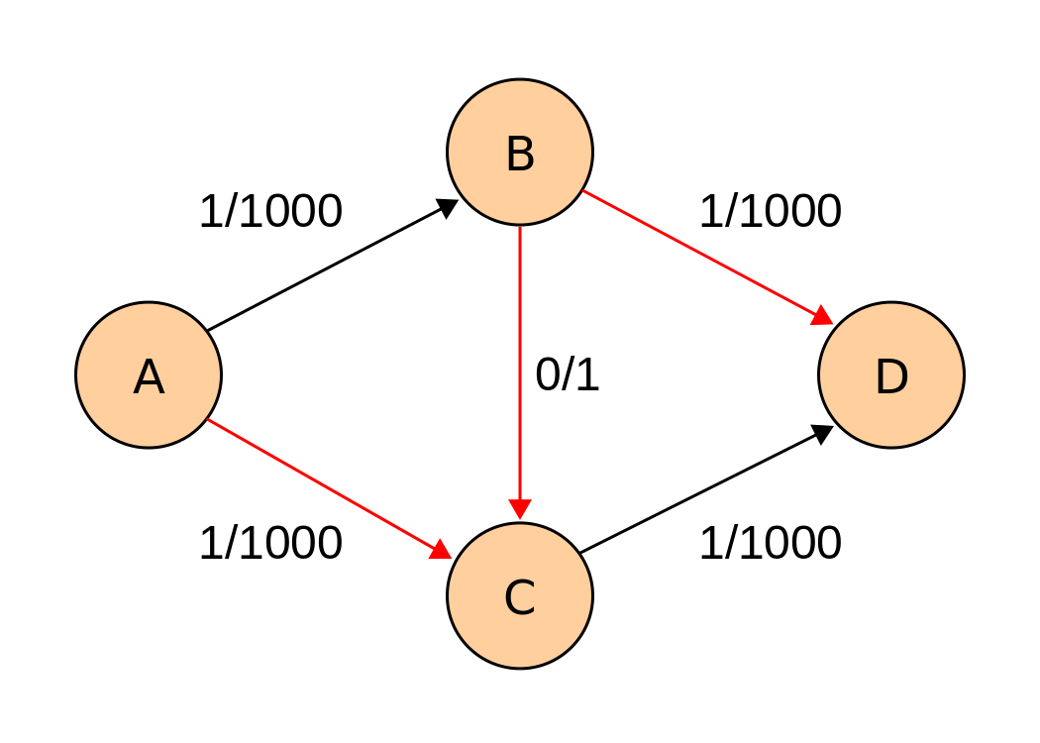
Ford-Fulkerson Problem
https://en.wikipedia.org/wiki/File:Ford-Fulkerson_example_2.svg

Slide 46
Ford-Fulkerson Problem
… 1998 more steps...

Slide 47
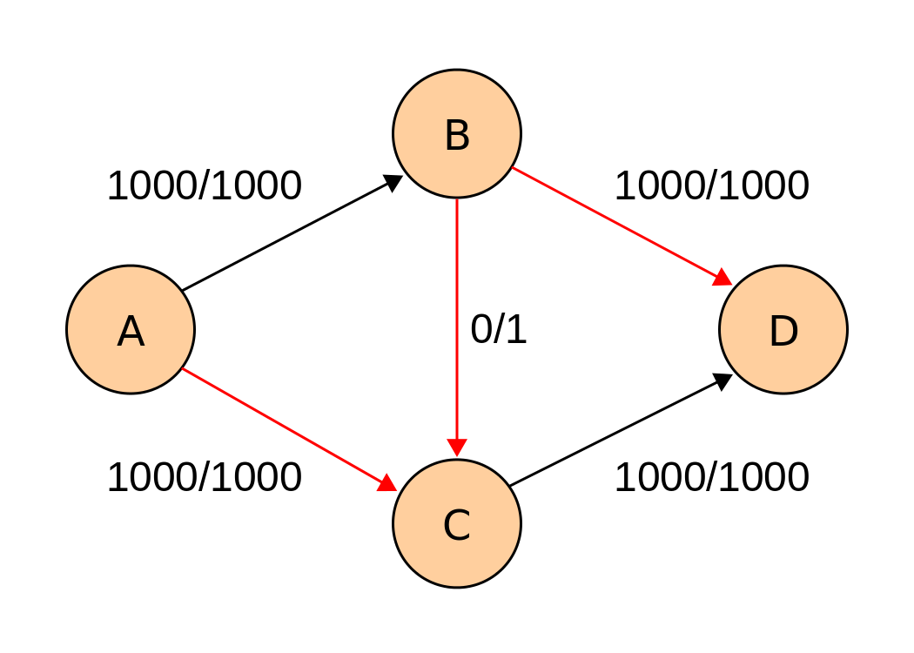
Ford-Fulkerson Problem
https://en.wikipedia.org/wiki/File:Ford-Fulkerson_example_0.svg

